Slide 1
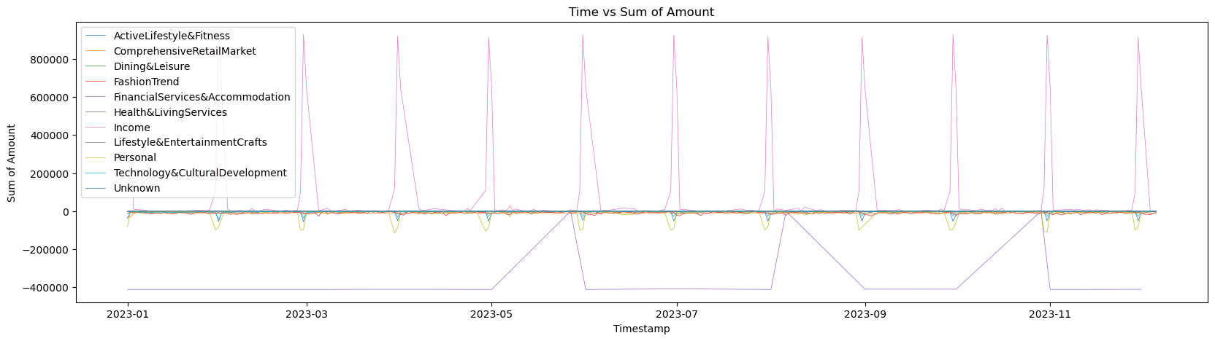
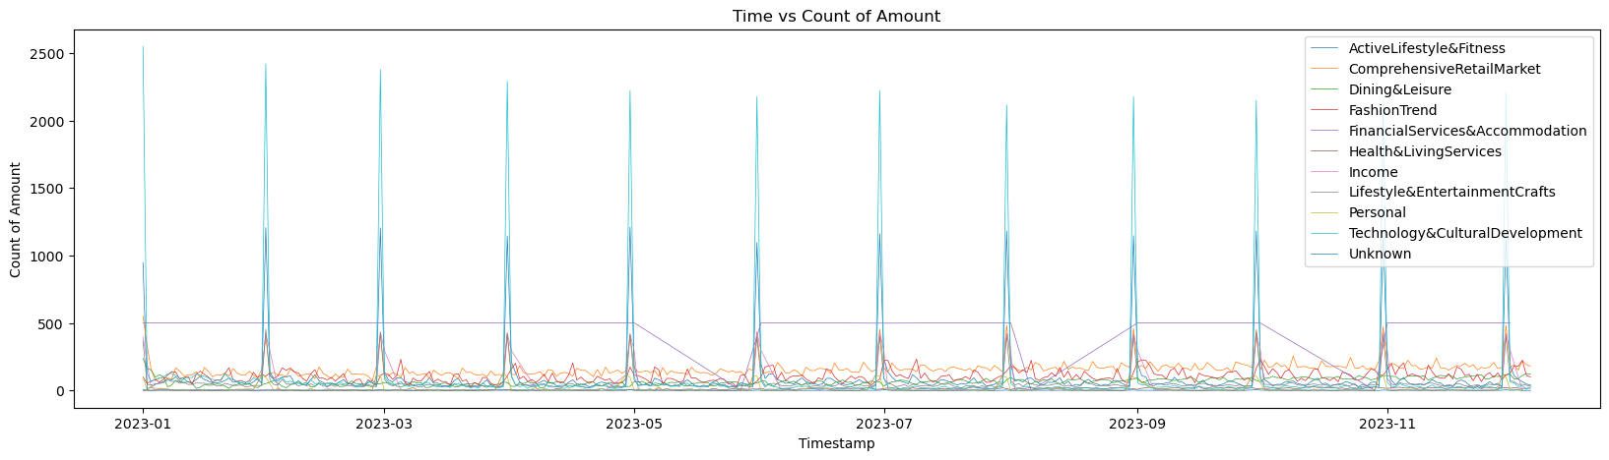
Analysis of Transaction Venue Categories
Distribution of Transaction Volume and Frequency by Location
Observations:
Bars: High transaction frequency, low average transaction value.
Supermarkets: Low transaction frequency, high average transaction value.
Bank Strategy Recommendations
Ensure stability of payment systems at bars.
Provide efficient large transaction processing services at supermarkets.
Introduce loyalty or reward programs tailored to merchants.
Notes:
In our exploration of data visualization, we focus on key variables including time, transaction location categories, and balances. Our analysis of transaction amounts and frequencies by location reveals that bars and supermarkets are prominent in terms of total transaction volume. The data illustrates that while bars experience higher transaction frequencies, the average transaction amount is relatively low. This underscores the necessity for banks to ensure the reliability of payment systems in such venues. In contrast, supermarkets show lower frequency but higher average transactions, indicating strong purchasing power among customers who tend to make larger purchases. Banks, therefore, must provide efficient services capable of processing large transactions at these locations and might consider introducing loyalty or reward programs to encourage repeat business.

Slide 2
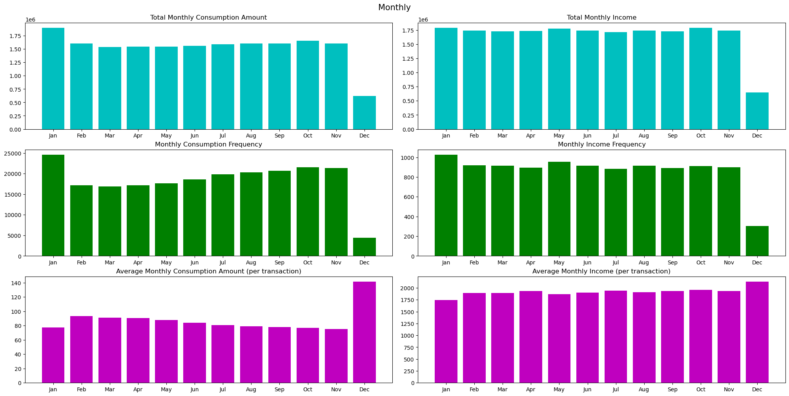
Year-End Consumption Trends
Analysis of Holiday Consumption Impact
Observations:
Significant increase in transaction volume and frequency during Christmas and New Year.
Consumption boosted by year-end bonus disbursements.
Bank Action Recommendations
Offer special holiday promotions and financial products.
Strengthen risk management to ensure transaction security.
Notes:
As depicted in our graphs for December 2025, both transaction volumes and frequencies exhibit a significant rise throughout the month, likely spurred by the festive season of Christmas and New Year. This period also coincides with many companies disbursing year-end bonuses, increasing individual disposable income and thus boosting consumer spending. Banks have an opportunity during this time to offer special promotions or financial products and should intensify risk management strategies to ensure the safety and stability of transactions during this peak period.

Slide 3
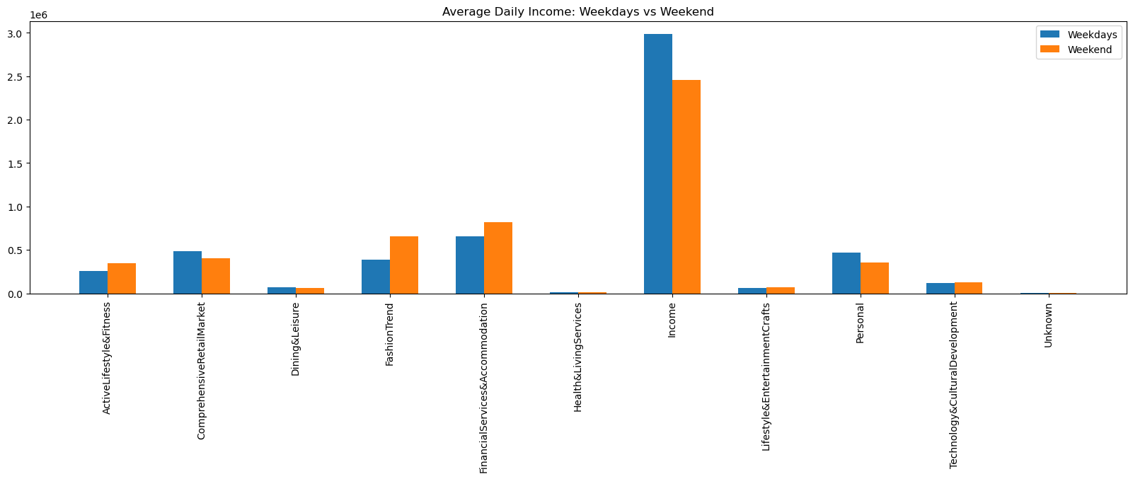
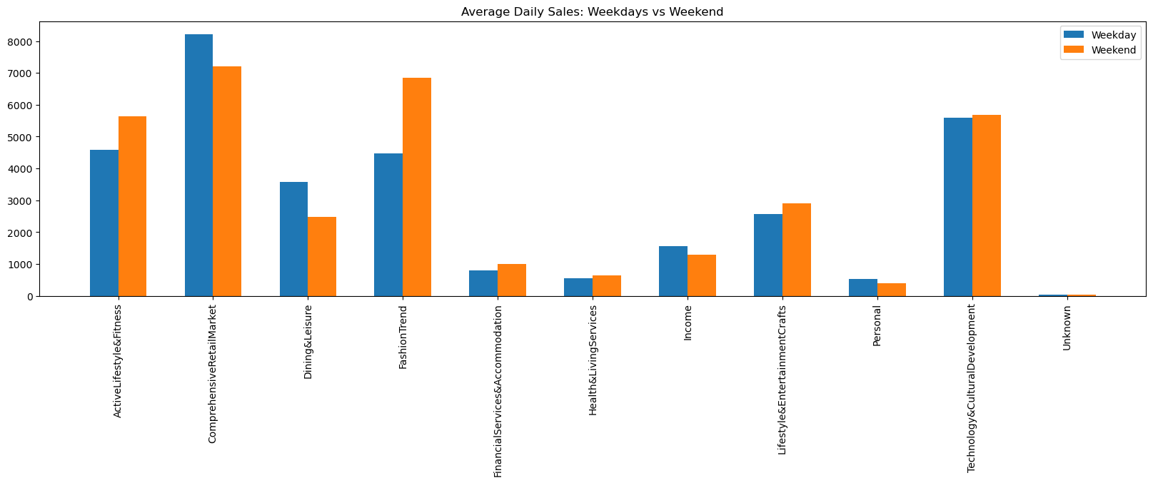
Analysis of Weekend Consumption Trends
Comparison of Weekend and Weekday Transactions
Observations:
Total transaction volume and frequency higher from Friday to Sunday compared to Monday to Thursday.
Increased consumption at bars and restaurants on weekends.
Weekend Performance of Consumption Venues
Bars and entertainment venues: Increase in transaction volume and frequency.
Supermarkets and online stores: Relatively stable transactions.
Notes:
Beyond annual trends, it is crucial to delve into the weekly transaction trends. We notice that from Monday to Thursday, both transaction totals and counts are significantly lower compared to Friday through Sunday. This likely reflects the increased time people have for financial transactions and shopping activities over the weekends. During weekends, venues such as bars and entertainment spots see increased totals and frequencies of transactions, whereas supermarkets and electronics stores maintain a stable flow of transactions. This suggests a preference for spending at leisure locations like bars and restaurants over the weekend, while shopping at supermarkets or electronics stores remains consistent.

